Slide 1

Presented by Confidence Ihediohamma
GLOBAL SUPERSTORE ANALYSIS
A Comprehensive Analysis of Sales, Profitability, and Regional Performance Trend across Global Superstore Product Categories and Markets

Slide 2

Table Of Content
Introduction
Data Visualization and Problem Statement
Business Questions
Challenges Faced and Recommendation
Conclusion

Slide 3
INTRODUCTION
This report highlights key performance insights across products, categories, regions, and customers. It identifies areas of underperformance, opportunities to boost profitability, and measures to improve cash flow and customer value. The following recommendations provide actionable steps to optimize overall business performance.

Slide 4
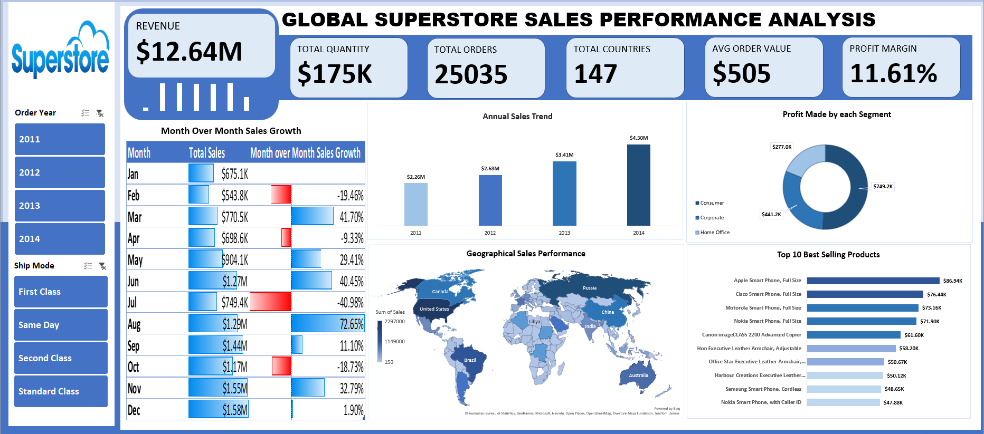

Slide 5
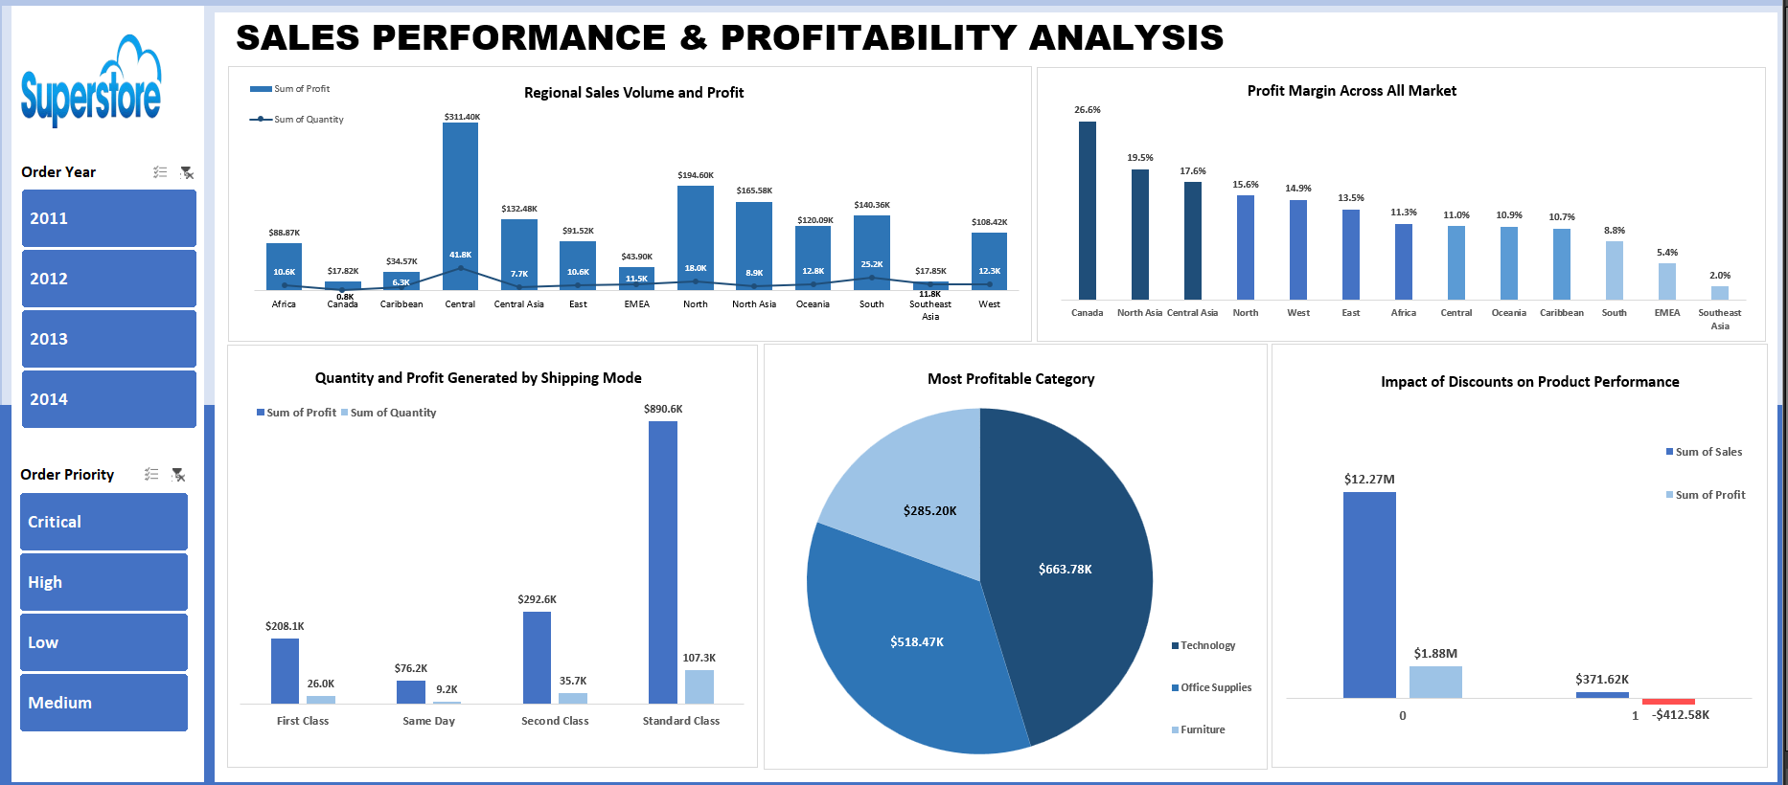

Slide 6
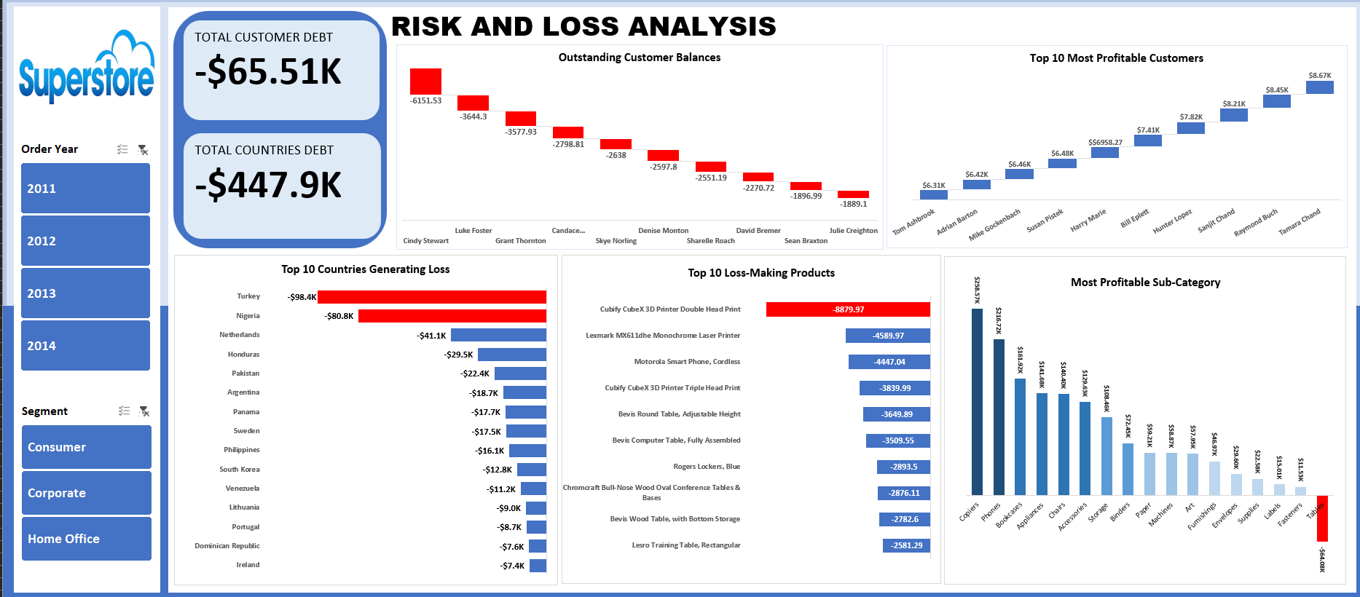

Slide 7

PROBLEM STATEMENT
The business is experiencing uneven performance across products, categories, and regions, with certain items generating losses while others remain highly profitable. Additionally, cash flow is impacted by outstanding customer balances, and high-value customers may not be fully leveraged for retention. These issues limit overall profitability and operational efficiency, necessitating targeted actions to address underperformance, optimize resources, and strengthen financial stability.

Slide 8


KEY PERFORMANCE INDICATORS
Total Revenue - $12.64M
This is the total income generated from all sales of goods from the stores globally.
Total Orders - 25,035
This is the total number of customer orders placed from all the store.
Total Quantity Sold: 175K
This is the total number of units sold across all regions.
Average Order Value: $505
This is the average amount spent per order across different markets.
Profit Margin: 11.61%
Percentage of revenue remains after deduction of expenses.
Total Customer Debt: -$65.51K
This is the net amount owed by customers
Total Customer Debt: -$65.51K
This is the net amount owed by customers

Slide 9

BUSINESS OBJECTIVES
This analysis was guided by the following business objectives:
Monitor overall sales and profit trends to assess business performance
Identify regions, products, and customers driving losses for targeted improvements
Highlight top-performing products and customers to inform growth strategies
Analyze discount strategies and their effect on profit margins
Manage outstanding customer balances to strengthen cash flow and reduce risk
Deliver actionable insights through data visualization for informed decision-making

Slide 10
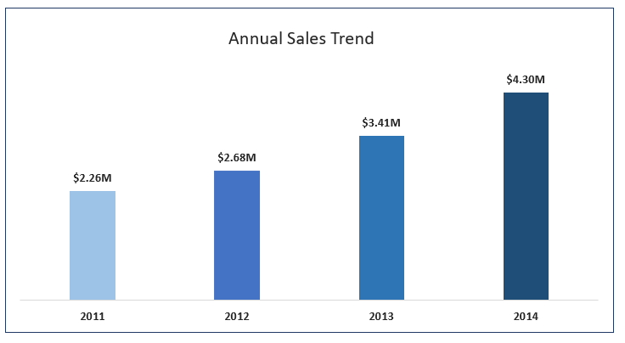
KEY INSIGHTS
TIME-BASED SALES PERFORMANCE ANALYSIS
Sales increased consistently every year, from 2011 to 2014, sales grew by $2.04M overall. That represents nearly 90% total growth over four years.

Slide 11
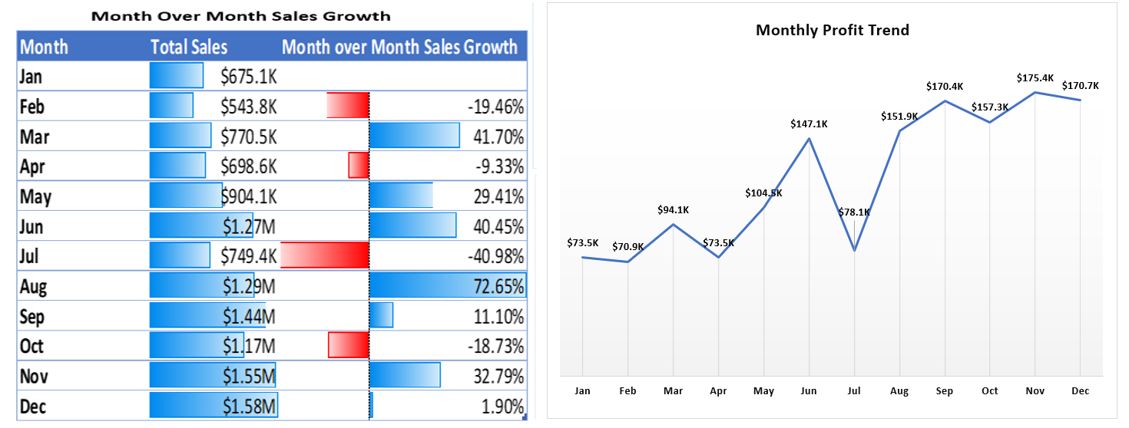
Q3 (July - Sep) and Q4 (Oct - Dec) are high-performance periods. July appears to be a recurring risk month with a decrease in sales and profit.
July shows both sales decline and profit drop. However, profit steadily improves toward Q4.
While December has the most sales, November generates the highest overall profit at $175.4K, followed closely by December ($170.7K) and September ($170.4K).

Slide 12
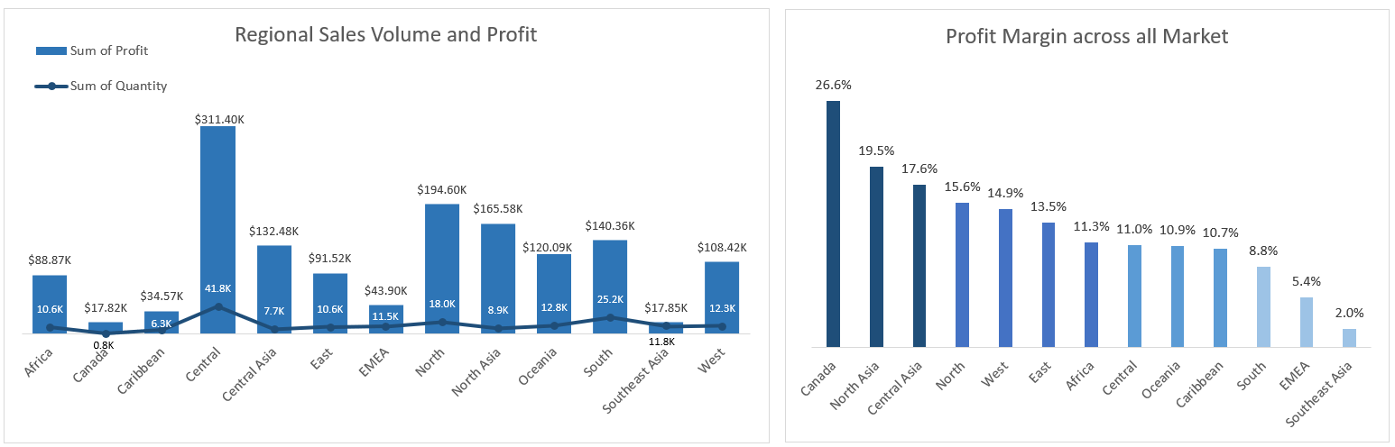
MARKET PERFORMANCE ANALYSIS
The Central region generates the highest total profit ($311.4K) driven by the largest sales volume (41.8K units), though its margin is moderate (11%).
South and Southeast Asia underperform due to low profit margins despite maintaining moderate to high sales volumes.
Canada has the highest profit margin at 26.6%, making it the most efficient and profitable region relative to revenue.

Slide 13
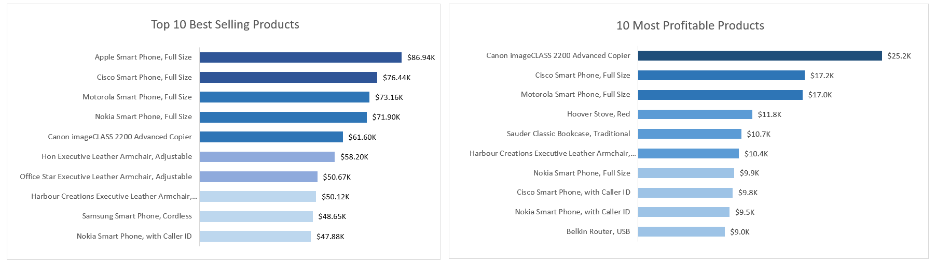
PRODUCT CATEGORY AND SUB-CATEGORY ANALYSIS
Cisco Smart Phone (Full Size), Motorola Smart Phone (Full Size), Nokia Smart Phone (Full Size), Canon imageCLASS 2200 Advanced Copier, and Nokia Smart Phone (with Caller ID) appears to be both high selling and profit generating, indicating strong profit alignment.
Apple Smart Phone (Full Size) leads in sales but does not add to profitability, suggesting thinner margins.
The Canon imageCLASS 2200 generates the highest profit but ranks fifth in revenue, showing strong margin efficiency.

Slide 14
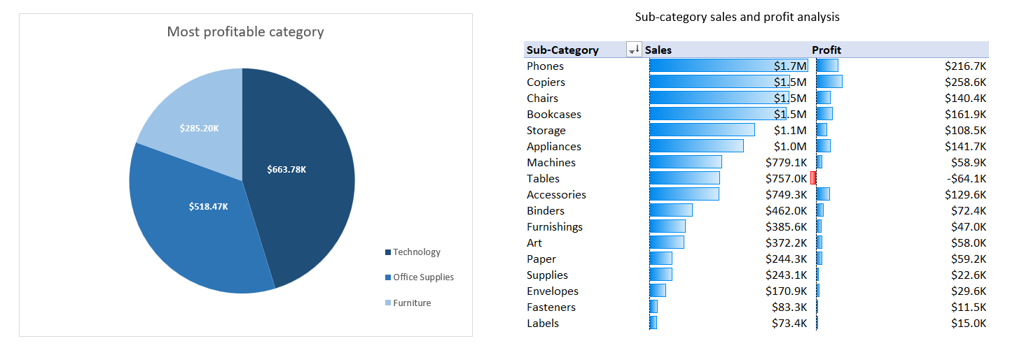
Category And Sub-category Analysis
Technology is the most profitable category, generating approximately $663.8K, making it the primary profit driver.
Copiers ($258.6K) generate the highest profit, followed by Phones ($216.7K).
Tables show moderate sales ($757K) but generate a loss (-$64.1K), indicating serious margin issues.
Machines generate approximately $58.9K profit on $779K in sales, indicating a relatively low profit to sales ratio and suggesting potential margin pressure that requires close monitoring and cost optimization review.

Slide 15
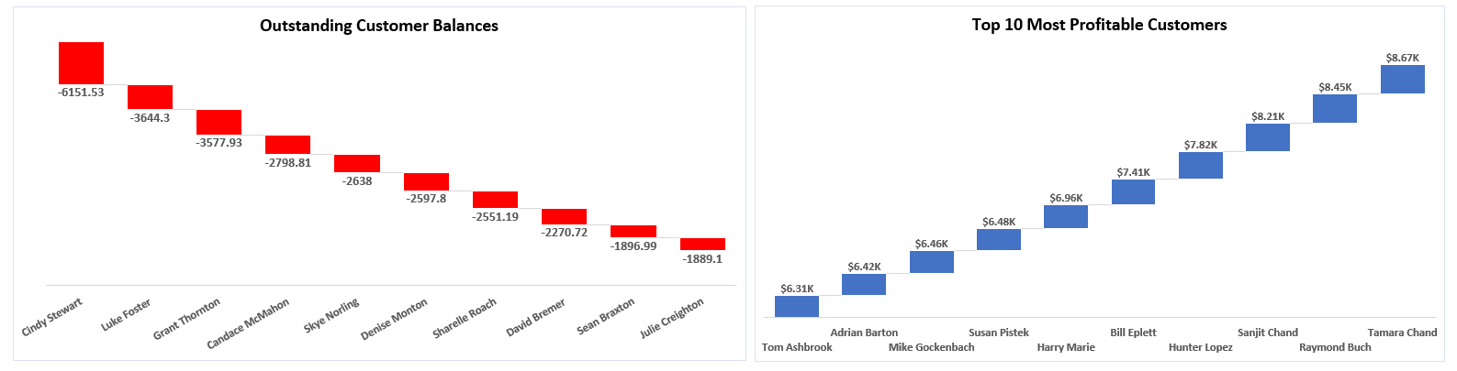
RISK AND LOSS ANALYSIS
Customer Performance
Cindy Stewart with an outstanding balance of (-$6,151).
Customers with large negative balances suggest delayed payments or extended credit terms.

Slide 16
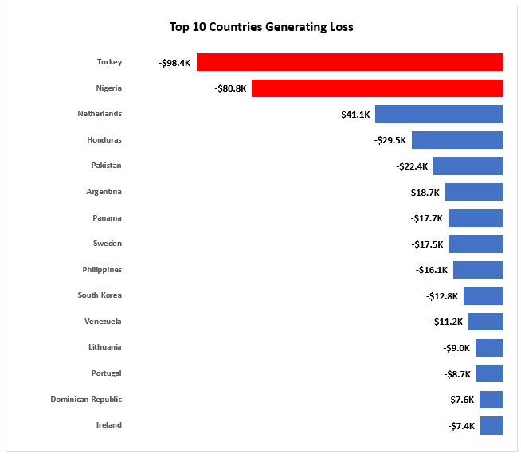
RISK AND LOSS ANALYSIS
Country Performance
Countries such as Turkey is the largest source of financial drain with a loss of -$98.4K, followed closely by Nigeria at -$80.8K, making these two countries the primary targets for urgent cost-cutting and strategy shifts.
Large losses in these countries suggest that logistics and shipping to these specific regions may be significantly eating into revenue.

Slide 17
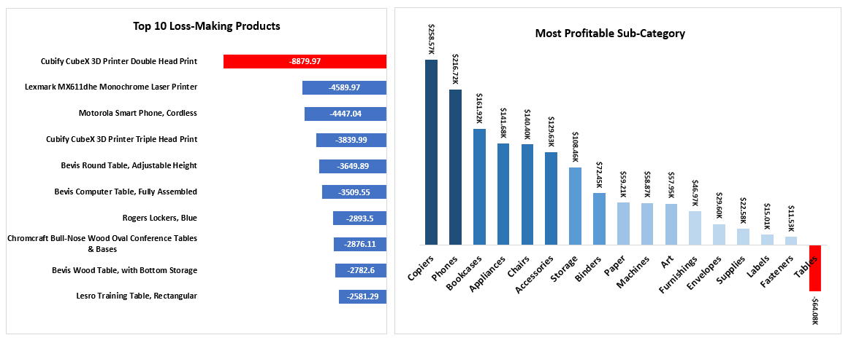
RISK AND LOSS ANALYSIS
Product Performance
The largest loss comes from the Cubify CubeX 3D Printer Double Head Print (-$8,879.97).
Tables is the only loss-making sub-category, generating a negative profit (−$64.1K)
Tables and storage products particularly from the Bevis and Rogers brands, consistently generate losses, indicating potential issues with pricing strategy, excessive discounting, or an unfavorable cost structure.
However, loss making products should first be reviewed for pricing errors, high cost of goods, or excessive discounting before discontinuation.

Slide 18
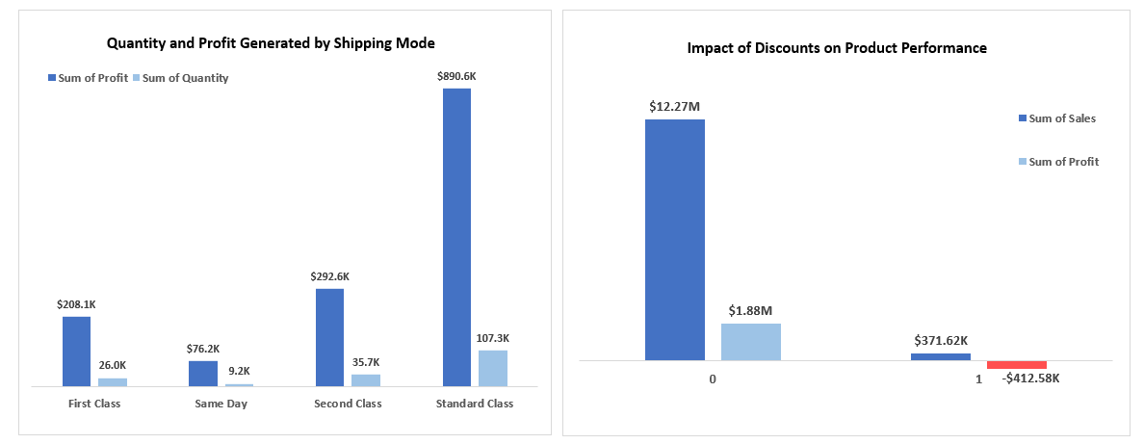
SHIPPING MODE AND DISCOUNT ANALYSIS
Standard Class is the most preferred and most profitable shipping method, generating significantly higher sales volume and profit than other shipping modes.
First Class generates reasonable profit but lower order volume, suggesting customers may use it only when faster delivery is needed.
Same Day delivery has very low demand and profitability, likely due to higher costs or limited customer preference.
Most revenue and profit come from products sold without discounts, indicating strong product demand even at full price.

Slide 19

RECOMMENDATION
Underperforming products: Tables, especially Cubify CubeX 3D Printer Double Head, show significant losses. Review pricing and logistics; consider removal in unprofitable regions if no improvement.
High-profit categories: Copiers and Phones should get priority in promotions and stock across physical and online channels.
Loss-making countries: Investigate causes in markets like Turkey and Nigeria (e.g., excessive discounts, high shipping costs, low demand).
Top customers: Focus on high-value clients like Tamara Chand, Raymond Buch, and Sanjit Chand with personalized offers or priority services to boost retention and value.
Outstanding balances: Improve collections through stricter credit controls, clearer terms, proactive follow-ups, and structured payment plans where needed.

Slide 20

CHALLENGES FACED AND HOW IT WAS SOLVED
Data Quality Issues: Missing values and inconsistent formatting.
Solved by data cleaning and standardization.
Profit Distortion Due to Discounts: Difficult to identify true profit drivers.
Solved by isolating discounted vs non-discounted performance.
Multi-Dimensional Analysis: Complex relationships across regions, categories, and time.
Solved by implementing a Star Schema data model.
Identifying True Loss Drivers: Sales did not equal profit.
Used sub-category and product-level drilldowns

Slide 21

CONCLUSION
The Global Superstore demonstrates strong revenue growth and expanding operations. However, profitability is being eroded by:
Excessive discounting
Loss-making furniture sub-categories (Tables)
Low-margin markets By optimizing discount policies, refining product mix, and focusing on high-margin markets, the business can significantly improve its overall profit margin beyond the current 11.61%.

Slide 22


